Slide 1

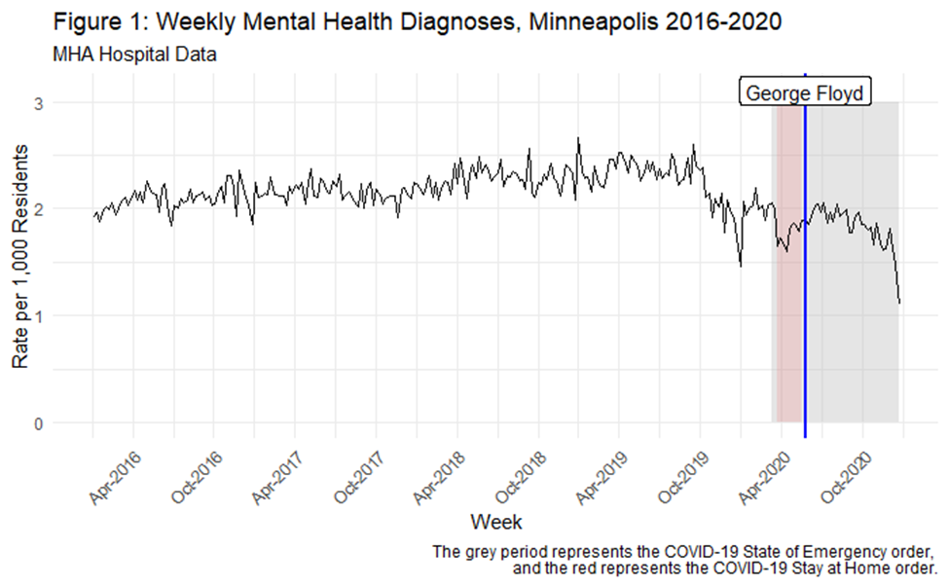
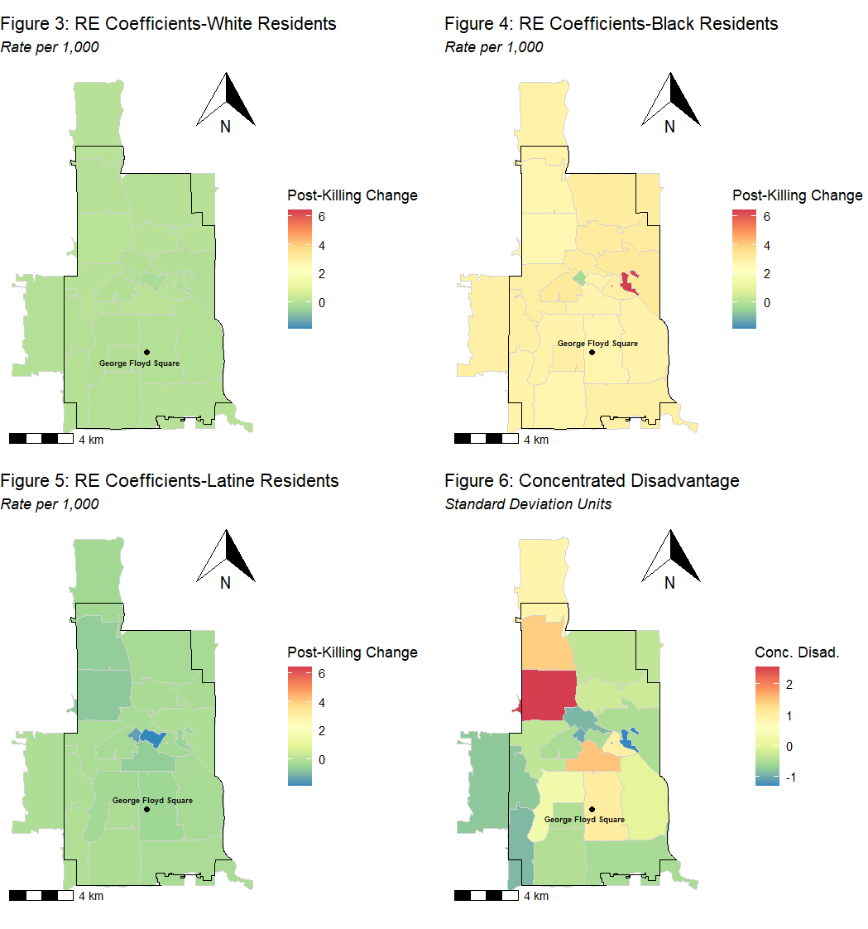
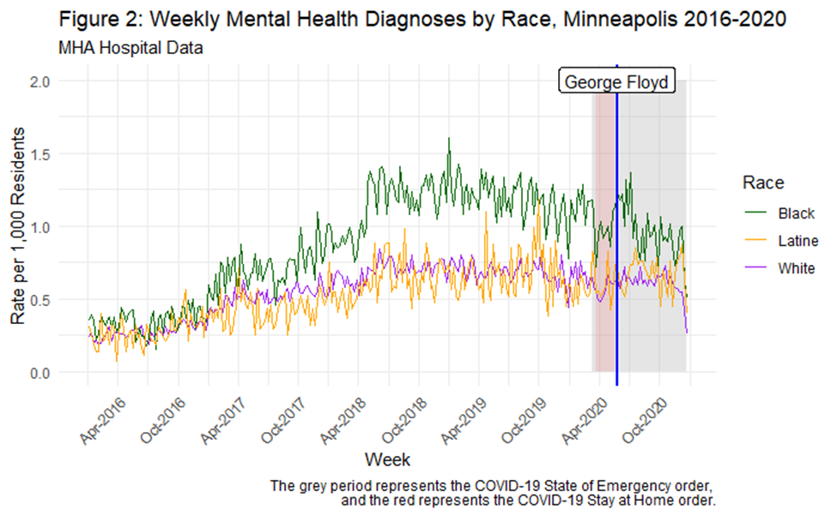

The Mental Health Consequences Before and After George Floyd’s Murder in Minneapolis in Black, Latine, and White Communities N. Jeanie Santaularia¹, Ryan Larson², Christopher E. Robertson³, Christopher Uggen³ 1. Department of Epidemiology, School of Public Health, the University of Washington; 2.Department of Criminal Justice and Forensic Science, Hamline University; 3. Department of Sociology, University of Minnesota
“History is not something you read about in a book; history is not even the past, it’s the present, because everybody operates, whether or not we know it, out of assumptions which are produced only, and only by our history.” –James Baldwin 1986
Introduction
Results
Conclusion
Racialized police violence has been pervasive throughout United States history.
Our study seeks to evaluate the rate of mental health diagnoses over time and space after the murder of Mr. Floyd on May 25th, 2020 in communities in Minneapolis, Minnesota.
Statistical Method:
Time-series plots of mental health diagnoses incidence
Autoregressive interrupted time-series models
Interrupted time series panel models for White, Black, and Latine racial subgroup with temporal autoregressive lags of mental health discharges :
Random ZCTA intercepts and ZCTA random Event coefficients on Zip Code Tabulation Area (ZCTA)-week level data
Random coefficient models with a cross-level interaction between the post-killing indicator and concentrated disadvantage
In the month pre-murder the rate of mental health diagnoses overall was 1.85/1,000, as compared to a rate of 1.93/1,000 post-murder
In the Black population the rate of mental health diagnoses post-murder was 1.15/1,000 as compared to a weekly rate of 1.02 in the month pre-murder (a 12.7% increase).
The White and Latine post-killing effects tend to be stronger (or less negative in the case of Latine residents) in areas of higher concentrated disadvantage.
Post-killing increases in Black mental health discharges were remarkably stable across space.
There are traumatizing effects of police violence in the short- and longer-term for communities, particularly Black communities
The racial subgroup models highlight the racial heterogeneity in the effect of police-killing on mental health diagnoses.
Residing in advantaged neighborhoods did not insulate Black people from experiencing mental health diagnoses post-murder of Mr. Floyd
Methods
Data merged on ZCTA and week in Minneapolis from 2016-2020 :
Minnesota Hospital Discharge Records
Minnesota Department of Natural Resources
Minneapolis Police Departments
American Community Survey
Additional results:
For questions please contact: Jeanie Santaularia njsanta@uw.edu

